Slide 1
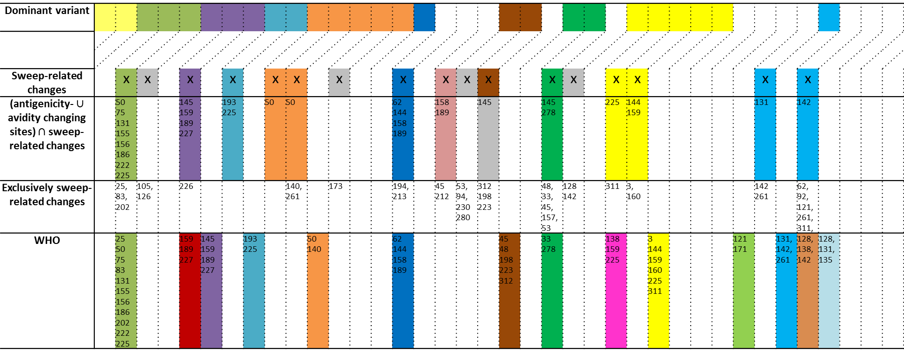
02 S
03 N
03 S
04 N
04 S
05 N
05 S
06 N
06 S
07 N
07 S
08 N
08 S
09 N
09 S
10 N
10 S
11 N
11 S
12 N
12 S
13 N
13 S
14 N
14 S
15 N
15 S
16 N
16S
17 N
17S
18N
18S
19N
19S
20N
20S
21N
Dominant variant
Sweep-related changes |  | x | x |  | x |  | x |  | x | x |  | x |  |  | x |  | x | x | x |  |  | x | x |  | x | x |  |  |  |  |  | x |  | x
(antigenicity- $∪$ avidity changing sites) $∩$ sweep-related changes |  | 50 75 131 155 156 186 222 225 |  |  | 145 159 189 227 |  | 193 225 |  | 50 | 50 |  |  |  |  | 62 144 158 189 |  | 158 189 |  | 145 |  |  | 145 278 |  |  | 225 | 144 159 |  |  |  |  |  | 131 |  | 142
Exclusively sweep-related changes |  | 25, 83, 202 | 105, 126 |  | 226 |  |  |  |  | 140, 261 |  | 173 |  |  | 194, 213 |  | 45 212 | 53, 94, 230 280 | 312 198 223 |  |  | 48, 33, 45, 157, 53 | 128 142 |  | 311 | 3, 160 |  |  |  |  |  | 142 261 |  | 62, 92, 121, 261, 311,
WHO |  | 25 50 75 83 131 155 156 186 202 222 225 |  |  | 159 189 227 | 145 159 189 227 |  | 193 225 |  |  | 50 140 |  |  |  | 62 144 158 189 |  |  |  |  | 45 48 198 223 312 |  | 33 278 |  |  | 138 159 225 |  | 3 144 159 160 225 311 |  |  |  | 121 171 |  | 131, 142, 261 | 128, 138, 142 | 128, 131, 135
 | A/Moscow/10/1999 |  | A/Wisconsin/67/2005 |  | A/Victoria/361/2011^{b} |  | A/Singapore/INFIMH-16-019/2016 | 3C.2a1
 | A/Fujian/411/2002 |  | A/Brisbane/10/2007 |  | A/Texas/50/2012^{b} |  | A/Switzerland/8060/2017 or A/Bretagne/1413/2017^{d} | 3C.2a2
 | A/California/07/2004 |  | A/Perth/16/2009ª |  | A/Switzerland/9715293/2013^{c} |  | A/Kansas/14/2017 | 3C.3a
 | A/Wellington/1/2004 |  | A/Victoria/208/2009ª |  | A/Hong Kong/4801/2014^{c} |  | A/South Australia/34/2019 | 3C.2a1b
Live updates

